Slide 2
Supermarket Sales
Using Power Bi & Excel & some python

Slide 3
KPIs
Financial KPIs
Sales & Operations KPIs
Total Revenue
The total value of all sales generated during a specific period.
Average Revenue per Invoice
Average amount spent by a customer per transaction.
Total Number of Invoices
Total number of completed transactions.
Average Quantity per Invoice
Average number of items purchased per transaction.

Slide 4
KPIs
Financial KPIs
Sales & Operations KPIs
Total Revenue
The total value of all sales generated during a specific period.
Average Revenue per Invoice
Average amount spent by a customer per transaction.
Total Number of Invoices
Total number of completed transactions.
Average Quantity per Invoice
Average number of items purchased per transaction.

Slide 5
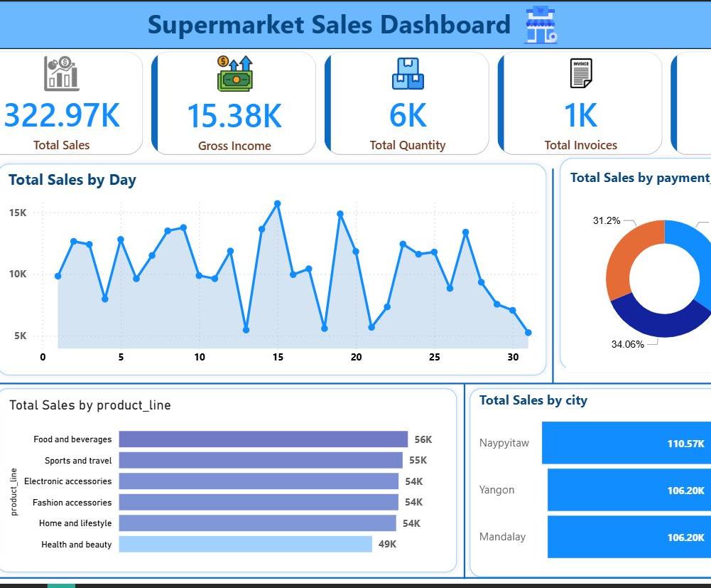

Supermarket Sales Dashboard Overview
⭐ Top KPIs at a glance:
-Total Sales: 322.97K
-Gross Income: 15.38K
-Total Quantity Sold: 6K
-Total Invoices: 1K
-Average Rating: 6.97
This dashboard effectively visualizes the supermarket’s sales data, allowing easy interpretation of complex information. It supports data-driven decision-making in sales planning, inventory management, customer experience, and market strategy.

Slide 6
Supermarket Sales Dashboard Overview
⭐ Top KPIs at a glance:
-Total Sales: 322.97K
-Gross Income: 15.38K
-Total Quantity Sold: 6K
-Total Invoices: 1K
-Average Rating: 6.97
This dashboard effectively visualizes the supermarket’s sales data, allowing easy interpretation of complex information. It supports data-driven decision-making in sales planning, inventory management, customer experience, and market strategy.

Slide 7

Branches

Slide 8
Branches

Slide 10
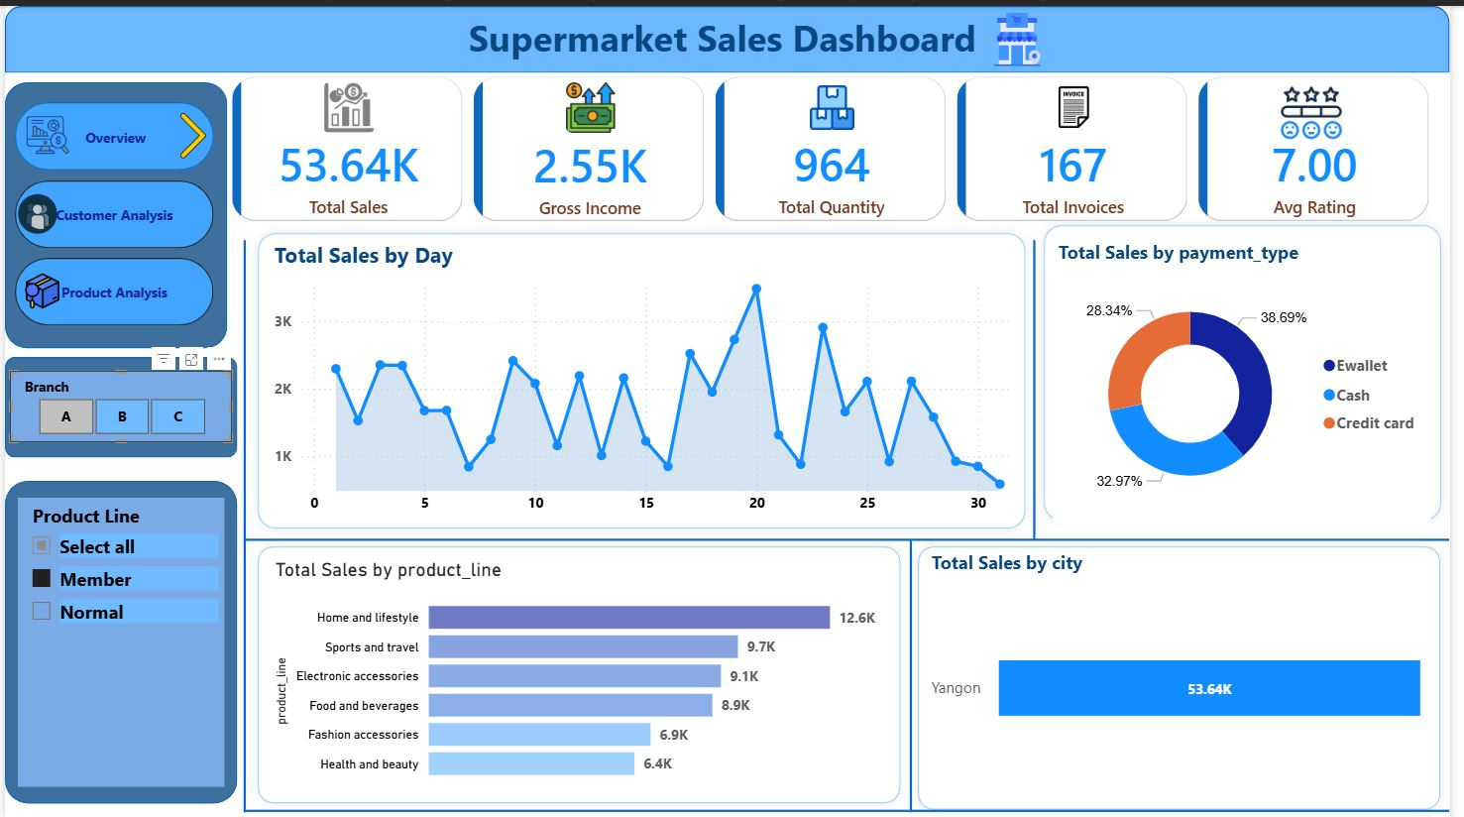
Dashboard Overview
C
B
For Member customers at Branch A, performance is solid with total sales exceeding 53K. The top-performing product categories are "Home and lifestyle" and "Sports and travel." The most popular payment method is E-wallet, and customer satisfaction is good with an average rating of 7.0 out of 10.
A

Slide 11
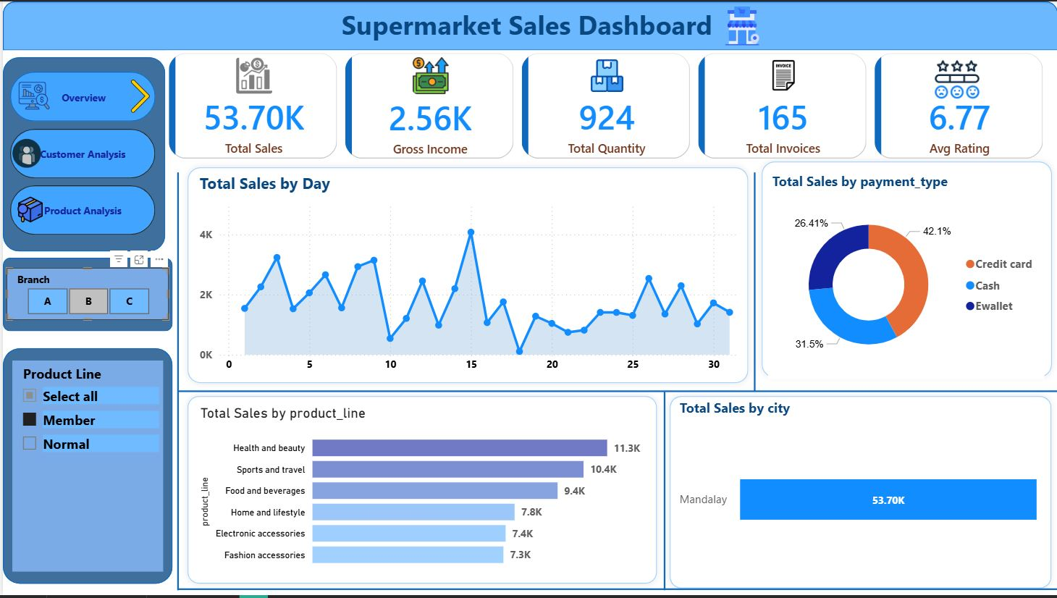
Dashboard Overview
C
For Member customers at Branch B, total sales are very close to Branch A (53.70K vs 53.64K previously). Top categories here are "Health and beauty" and "Sports and travel," with Credit card being the most popular payment method. Average customer rating is slightly lower at 6.77 compared to Branch A's 7.00.
B
A

Slide 12
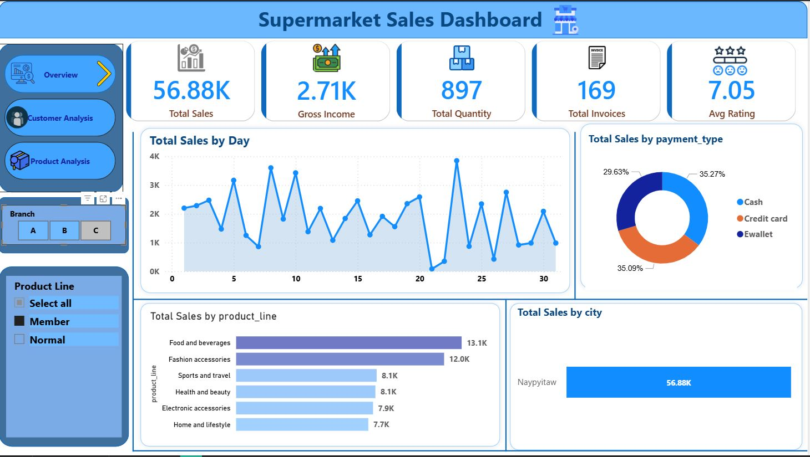
Dashboard Overview
Branch C shows the highest total sales among the three branches for Member customers (56.88K), slightly ahead of Branch A (53.64K) and Branch B (53.70K). Top categories are "Food and beverages" and "Fashion accessories." Payment methods are fairly balanced, with Cash and E-wallet nearly tied as the most popular. Customer satisfaction is solid with the highest average rating of 7.05 across the branches.
C
B
A

Slide 13
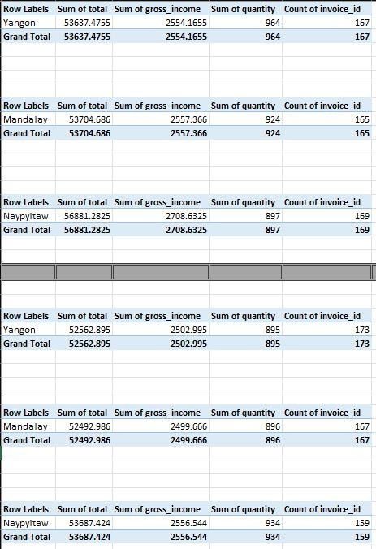
Branches
By transforming sales data into actionable insights, the supermarket can improve operational efficiency, enhance customer satisfaction, and drive sustainable revenue growth.

Slide 14
Branches
By transforming sales data into actionable insights, the supermarket can improve operational efficiency, enhance customer satisfaction, and drive sustainable revenue growth.

Slide 15
Male Member Excel in every Branch
Row Labels | Sum of total2 | Count of branch | Sum of quantity
Mandalay | 26854.254 | 80 | 445
Naypyitaw | 22227.8385 | 73 | 349
Yangon | 26994.408 | 87 | 499
Grand Total | 76076.5005 | 240 | 1293

Slide 16
Male Member Excel in every Branch
Row Labels | Sum of total2 | Count of branch | Sum of quantity
Mandalay | 26854.254 | 80 | 445
Naypyitaw | 22227.8385 | 73 | 349
Yangon | 26994.408 | 87 | 499
Grand Total | 76076.5005 | 240 | 1293

Slide 17




DATA
INFO
KNW
WISE
Information helps in decision-making.
Information is created when data is analyzed, classified, organized, or summarized.
It is gained through learning, experience, and thinking.
Knowledge helps you make decisions and solve problems.
It is more deep and applied than information.
It involves experience, morals, judgment, and foresight
It helps people choose the best action, not just a correct one
It is often called “knowing what truly matters”
Data by itself doesn’t tell you much.
But when you organize, analyze, or interpret it, it becomes information or knowledge.

Slide 18
DATA
INFO
KNW
WISE
Information helps in decision-making.
Information is created when data is analyzed, classified, organized, or summarized.
It is gained through learning, experience, and thinking.
Knowledge helps you make decisions and solve problems.
It is more deep and applied than information.
It involves experience, morals, judgment, and foresight
It helps people choose the best action, not just a correct one
It is often called “knowing what truly matters”
Data by itself doesn’t tell you much.
But when you organize, analyze, or interpret it, it becomes information or knowledge.

Slide 19
KNW
INFO
DATA
WISE
Information helps in decision-making.
Information is created when data is analyzed, classified, organized, or summarized.
It is gained through learning, experience, and thinking.
Knowledge helps you make decisions and solve problems.
It is more deep and applied than information.
It involves experience, morals, judgment, and foresight
It helps people choose the best action, not just a correct one
It is often called “knowing what truly matters”
Thanks
Data by itself doesn’t tell you much.
But when you organize, analyze, or interpret it, it becomes information or knowledge.
مؤمن سيد عمران - 20240227
يوسف ياسر فتحي - 20241239
ابوبكر سعيد عثمان - 20241974
سامر مجدي عزمي - 20241503
© 2025 All rights reserved

